Slide 1

Indeed job scraping and analysis
Colin Green

Slide 2
Problem Statement
Job hunting is tedious and time consuming
Job descriptions are ads meant to attract as many applicants as possible
Search algorithms struggle to find key differences between similar jobs
I am looking for entry level jobs focused on data science, machine learning, and/or data analytics
Many of the job postings I see are Business Analyst positions with a focus on sales, management, or marketing

Slide 3
Overall goal
Streamline my job search while reducing the number of unrelated posts that I must sift through
Rank the job postings based on their similarity to jobs that I have applied to in the past

Slide 4
Expectation
Jobs I will apply to
Python
R
SQL
Machine Learning
Data Science
Math/Physics
Entry-Level/Intern
Jobs I won’t apply to
Manager
Director
Sales
Web
PhD
Machining
Full Stack

Slide 5
Web scraping – beautiful soup
Begin by creating URLS
Input includes search terms, city, province, location radius, and date range
Outputs a list of URLs (as strings) based on the format that indeed accepts
Next I used the requests package to retrieve the information from the web for each URL
Using the Beautiful Soup package, I parsed each page to turn it into something readable

Slide 6
Basic function syntax
def extract_job_title_from_result(soups):
jobs = []
for soup in soups:
for div in soup.find_all(name='div', attrs={'class': 'row'}):
for a in div.find_all(name='a', attrs={'data-tn-element': 'jobTitle'}):
jobs.append(a['title'])
return(jobs)

Slide 7
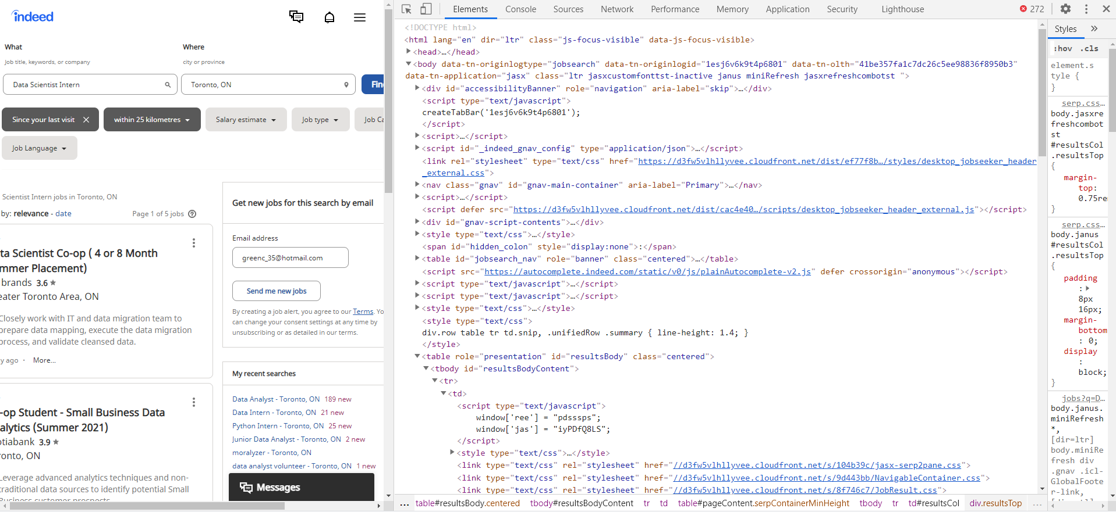

Slide 8
Extracting information
From this information I extracted:
Job Titles
Company Names
Locations
HREF Link
Job descriptions (the goal) are not saved on the main search results page
I can use the first function and the HREF links to get the full information for each job listed

Slide 9
Remove duplicates
Many jobs will show up in more than one search
After retrieving the job description, I pass it through a function that creates a dataframe using all of the scraped information
I removed duplicates based on job title and company name
Finally I saved the data as a csv file

Slide 10
Data labeling
I went through and labeled each job posting (-400 postings)
I labeled them as “Yes” I would apply for the job or “No” I would not apply
This was time consuming but I did it slowly over the last month
In the future I would consider trying out some form of clustering in order to avoid this
I had to skim through HTML and may not have been as consistent as I should have been

Slide 11
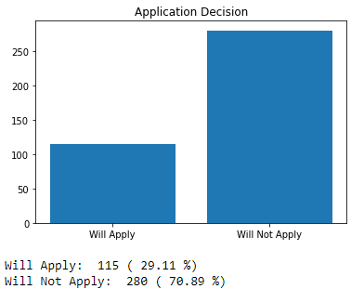
Data Labels

Slide 12
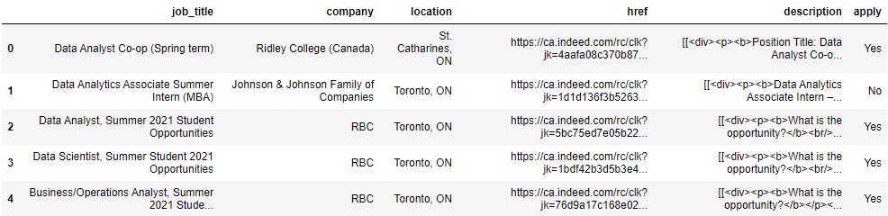
preprocessing

Slide 13
preprocessing
HTML is really messy
I created a cleanHTML function that used a regex to remove all of the tags (<div>)
I also had to remove special characters (“, ”, â€™, \n, etc…)
Next I ran it through a tokenizer that would remove punctuation, braces, excess whitespace and set everything to lowercase
Finally I removed all of the stopwords and numbers

Slide 14
A note on numbers
Numbers could be really useful (ie, 5 years of experience)
But there were enough numbers caused by the messiness of the HTML that the problems outweighed the benefits

Slide 15
Datasets
I compiled the data into 3 different formats
TFIDF
3870 Features
Bag of Words
9780 Features
nGrams (n=2)
87625 Features

Slide 16
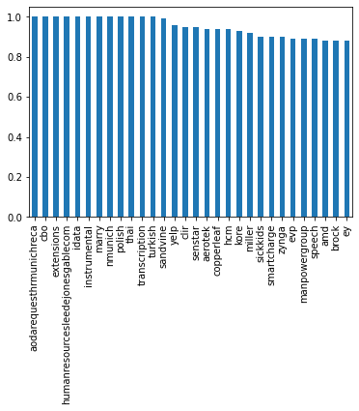
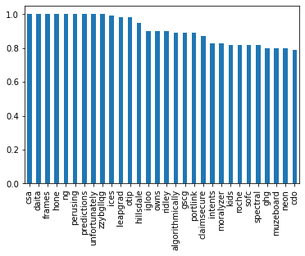
Data exploration – tf-idf
Will Not Apply
Will Apply

Slide 17
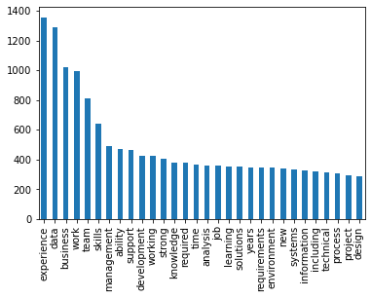
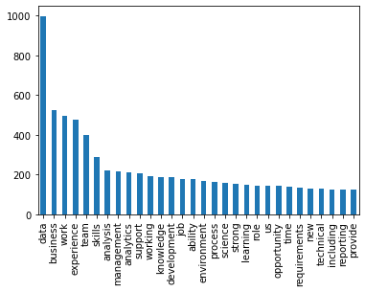
Data Exploration - BOW
Will Not Apply
Will Apply

Slide 18
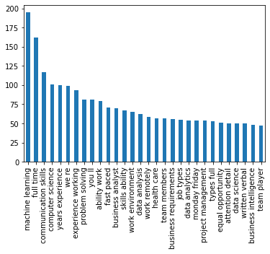
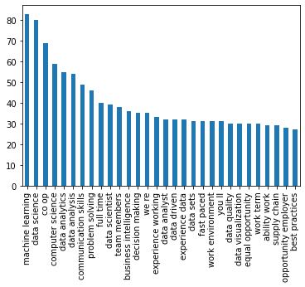
Data Exploration - ngrams
Will Not Apply
Will Apply

Slide 19
Preliminary modeling

Slide 20
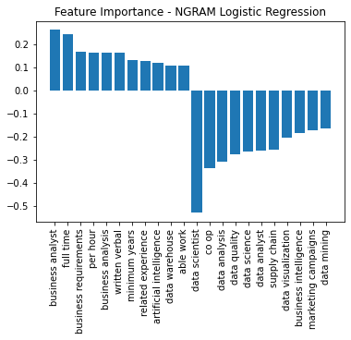
Feature importance

Slide 21
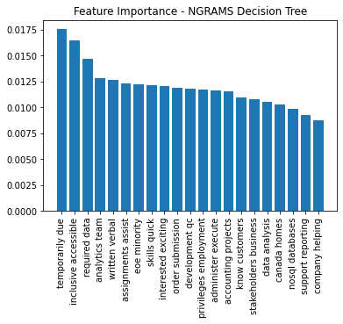
Feature importance

Slide 22
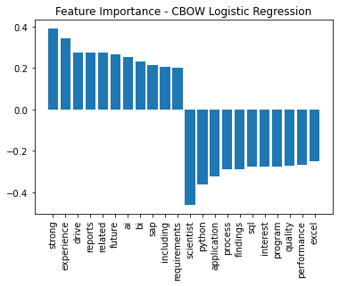
Feature importance

Slide 23
summary
Successfully scraped the information needed from indeed
Parsed through and cleaned the data
CBOW and nGrams outperformed TF-IDF in preliminary modeling
Successfully identified features that matched my expectations
Limits:
Only able to search on Indeed
400 Jobs from the last 7 weeks
30%/70% label split
Labels have very similar data
Job Boards have additional data points that I don’t have access to

